Slide 1

React
Styled Component

Slide 2
# Table of Contents
Styled Components.
Create UI Component with Styled.
Refactor Component with Styled.

Slide 3
# Break Changes
Tidak ada rekaman ulang kuliah.
Final project UAS hanya 1 minggu.
Tidak ada perbaikan plagiasi.
Absensi hanya di jam kuliah.
Backup nilai: Sertifikasi Frontend FCC.
Note:
Sertifikasi hanya backup nilai tugas.
Sertifikasi bukan pengganti nilai Final Project.

Slide 4
Review

Slide 5
# Review
JSX.
Styling: CSS Modules.
Mapping (memisahkan) between Component and Style.

Slide 6
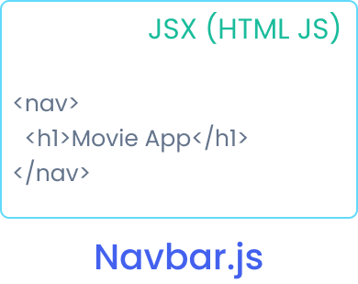
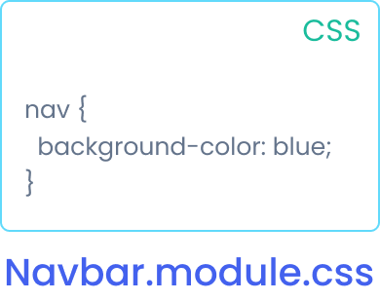
Mapping (read: memisahkan) between Component and Style

Slide 7
# Styling
Regular CSS.
CSS Modules.
SASS/SCSS.
CSS-in-JS: Styled-Components, JSS, Emotion.
UI Framework: Chakra, Material, Ant.

Slide 8
Styled Component

Slide 9
# Styled
CSS-in-JS library.
Create Component and Style at once.
Removing mapping between Component and Style.
Use tagged template literals.
Referensi: Styled - Docs.

Slide 10
# Why - Motivation
Automatic critical CSS
No class name bugs
Easier deletion of CSS
Dynamic styling
Automatic vendor prefixing
Referensi: Styled - Motivation

Slide 11
# Install
Install via npm, yarn, cdn
Install: npm i styled-components (use s at the end).
Extension: vscode-styled-components.
Referensi: Styled - Installation.

Slide 12
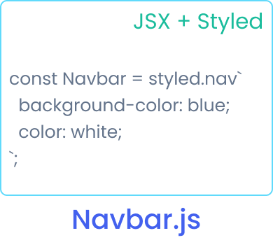
Remove mapping between Component and Style.

Slide 13
# Tagged Templates
Template Literals: `string ${expression}`.
Another features of template literals.
Parse template literals with a function: func`string`
Styled Component uses Tagged Template.
Referensi: Styled - Tagged Template.

Slide 14
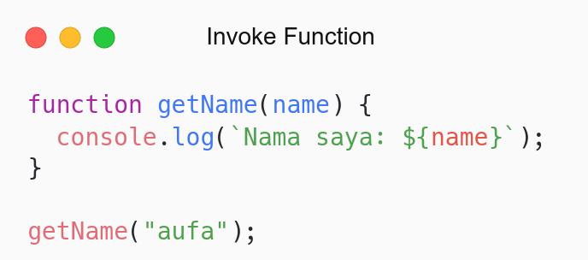
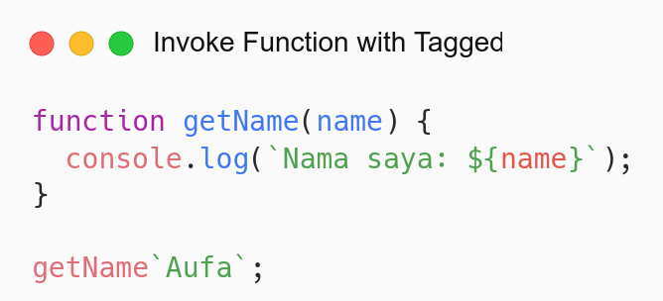

Slide 15
# UI Component
UI Component: Reusable, independent and used anywhere component.
Make UI Component like UI Framework: Chakra, Material, Ant
Case UI: Button Component.
Save in ui folder: components/ui.

Slide 16
# Getting Started
Make Button Component.
Button Component: components/ui/Button/index.js
Have some props.
Props:
Variant: Mengatur jenis warna.
Full: Membuat full width.
Size: Mengatur ukuran.
Referensi: Styled - Getting Started.

Slide 17
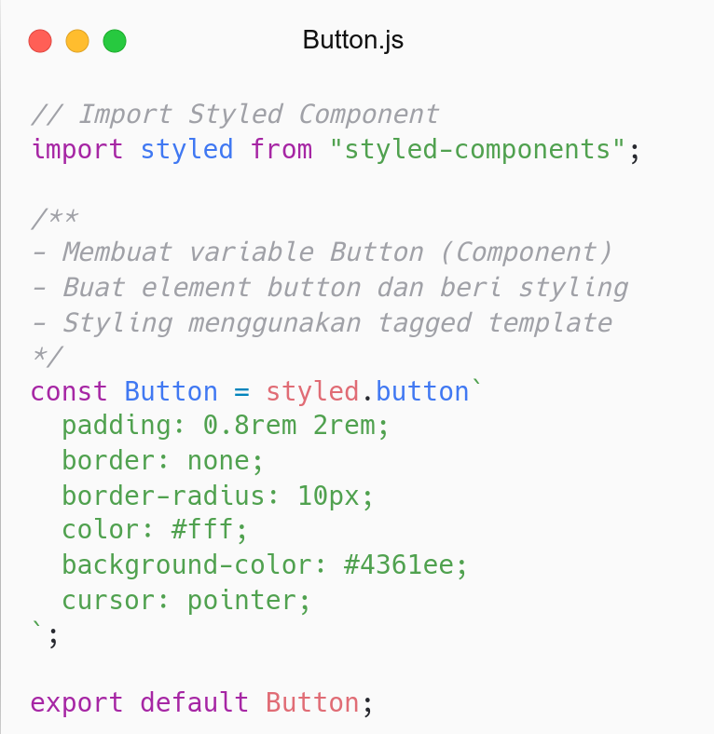
Button Component can used anywhere.
Use Button in Hero Component.

Slide 18
# Passing Props
Props can be passed to Styled Component.
Make component dynamic.
Use function (interpolation) to access Props.
Referensi: Styled - Passed Props.

Slide 19
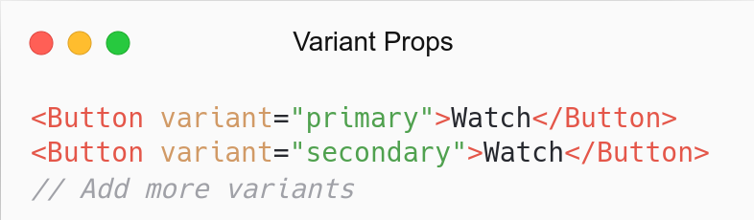


Render Button based on variant (Props).

Slide 20
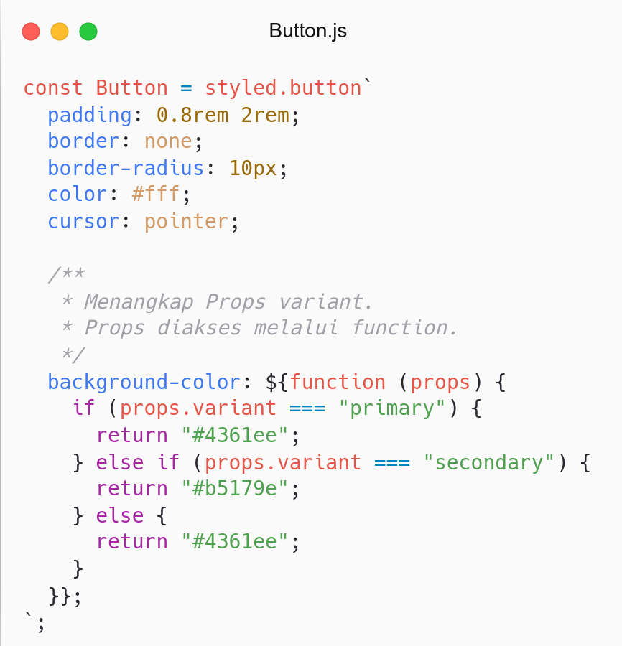

Slide 21
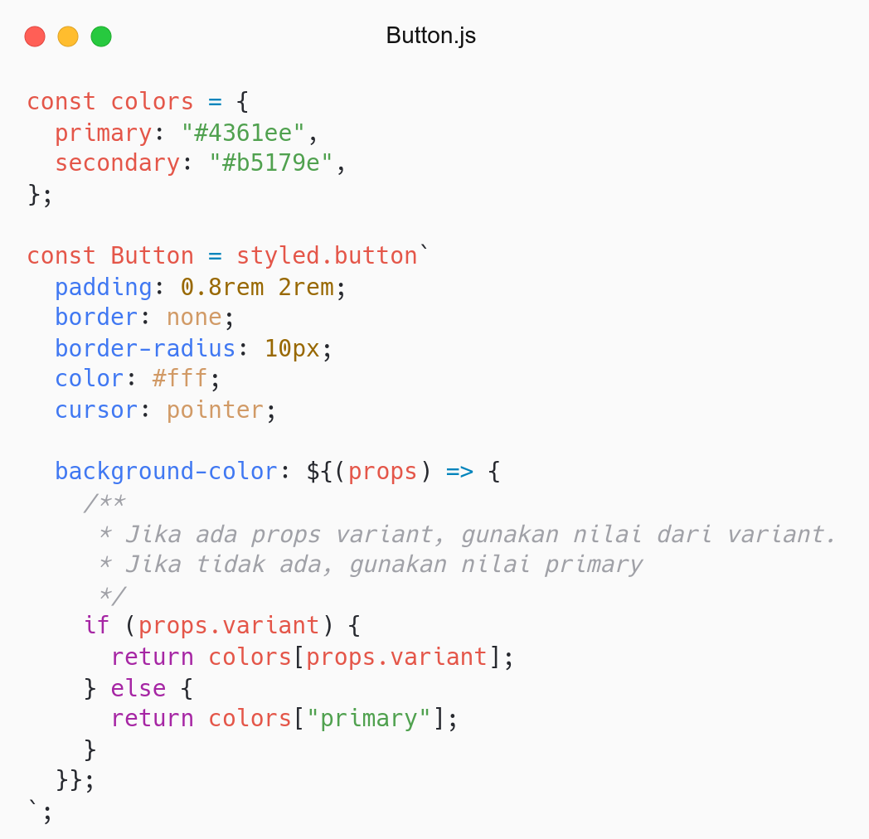
Refactor:
Use Arrow Function.
Save colors in object.
Note:
Use bracket notation to access property

Slide 22
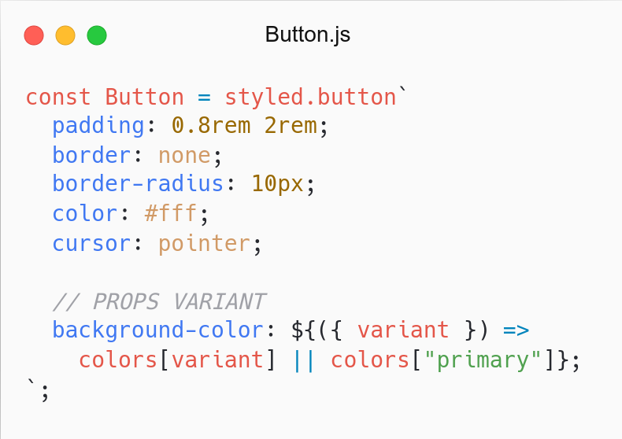
Refactor:
Destructing in params
Shorthand ternary operator

Slide 23
# Add More CSS
Add more CSS based on Props.
Use css helper from Styled.
Referensi: Styled - CSS Helper.

Slide 24
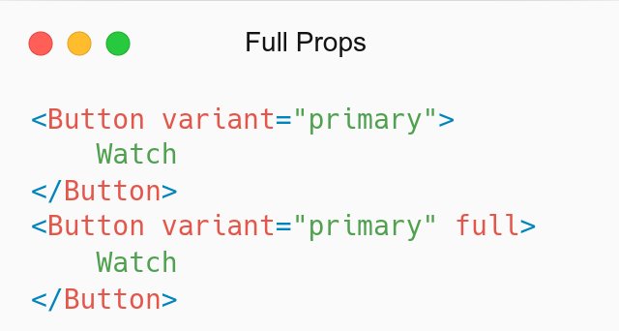


Make full width button if full (props) passed.

Slide 25
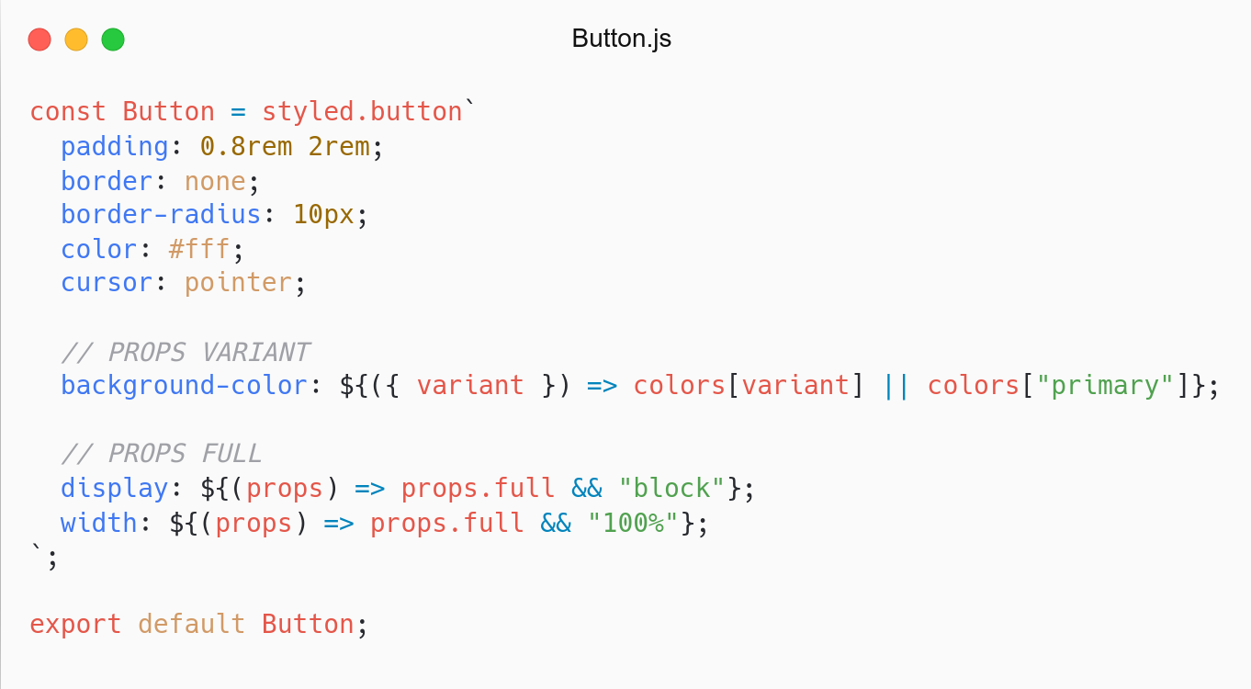
Previous way.
Use full (props) in display and width property.

Slide 26
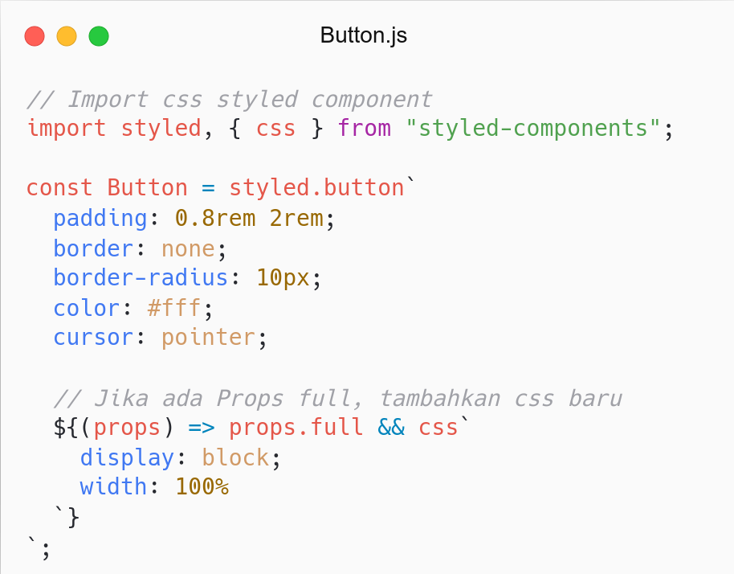
Use css helper.
Add more property based on full (props).
Same as before, but more concise.
Use Button (full) in Form Component.

Slide 27
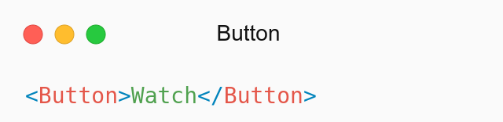
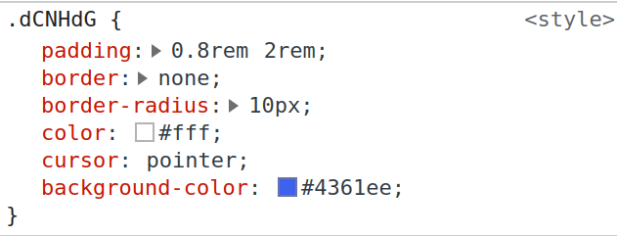
How about performance?
Property was not added if Props was not passed.
Remove unused styles.
Don’t worry has many Props.

Slide 28
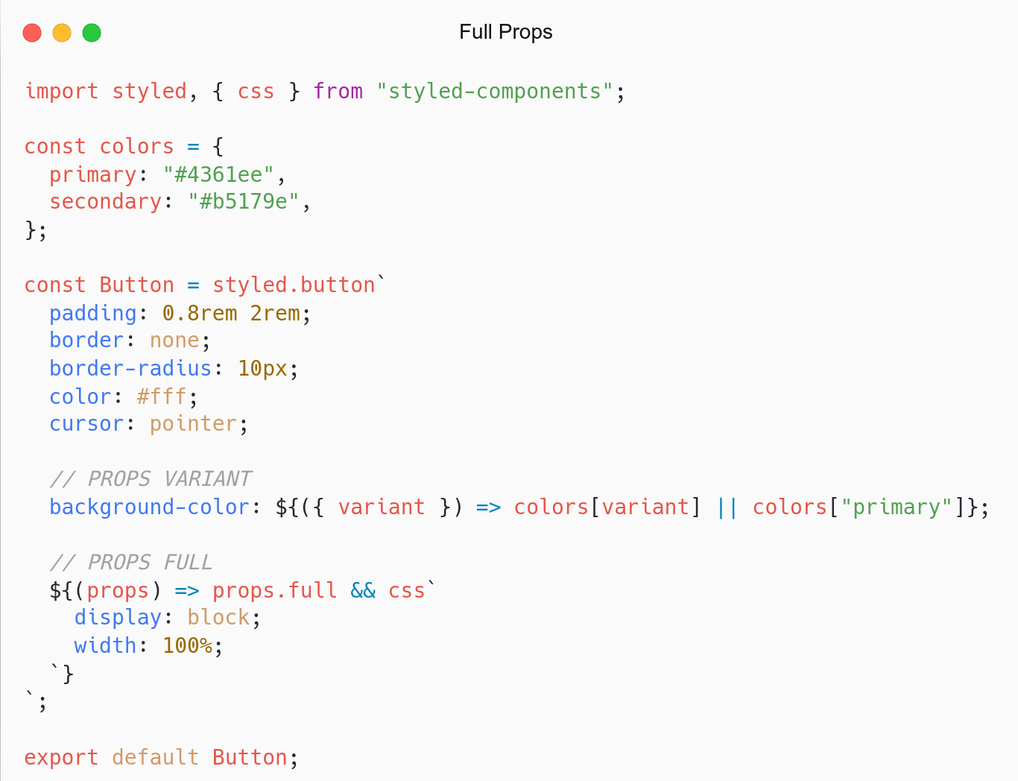
Button become reusable and dynamic component.
Try to add other props:, margin, padding, size.
What if colors theme used in others? Theming.

Slide 29
# Theming
Styled support full-theming.
Use Theme Provider Component.
Make style more consistent.
Theme: utils/constants/theme.js
Referensi: Styled - Theming.

Slide 30
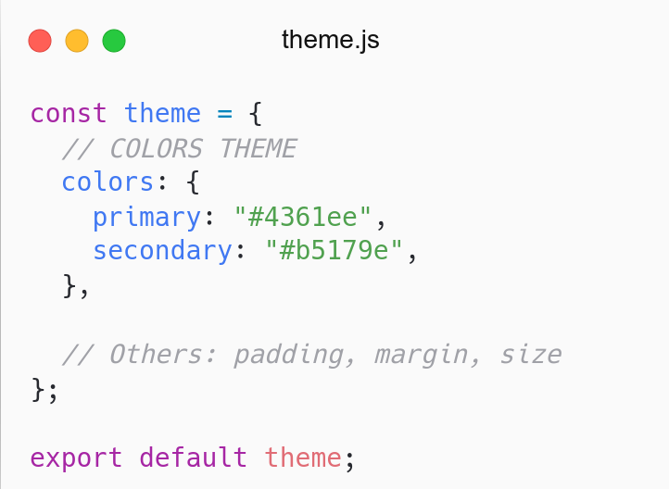
Create Color Theme.
How to use this theme in Styled?

Slide 31
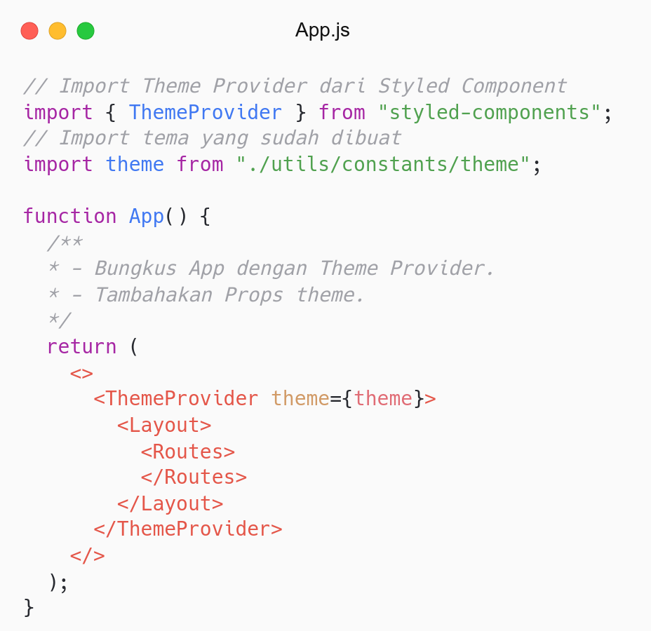
Wrap App with Theme Provider Component.
Set theme (props).
Now, access theme in Styled.

Slide 32
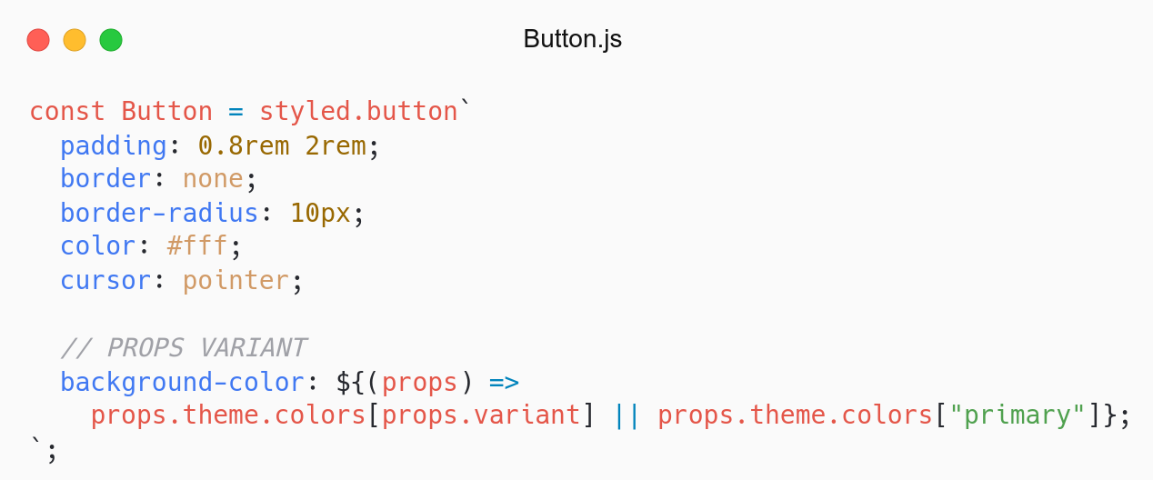
Access theme via theme Props.
Try destructing variant and theme in params

Slide 33
# Global Style
Apply Global Style to app.
Global Style: CSS Reset, Font
Using createGlobalStyle helper.
Global Style: components/GlobalStyle/index.js
Referensi: Styled - Global Style.

Slide 34
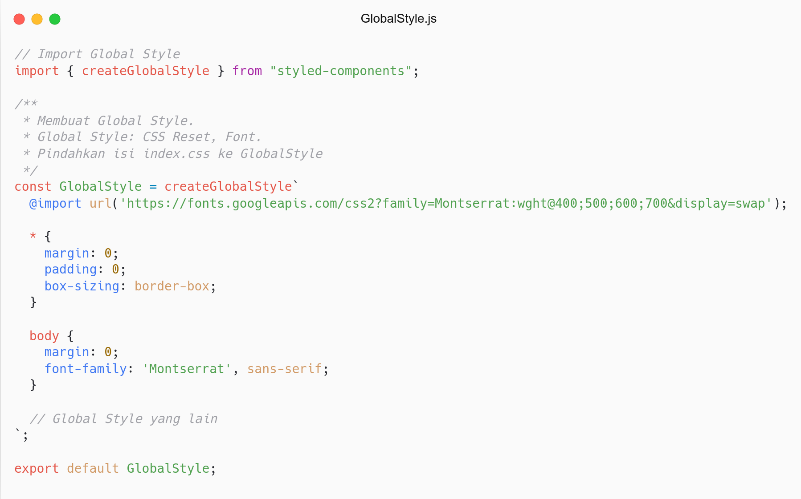

Slide 35
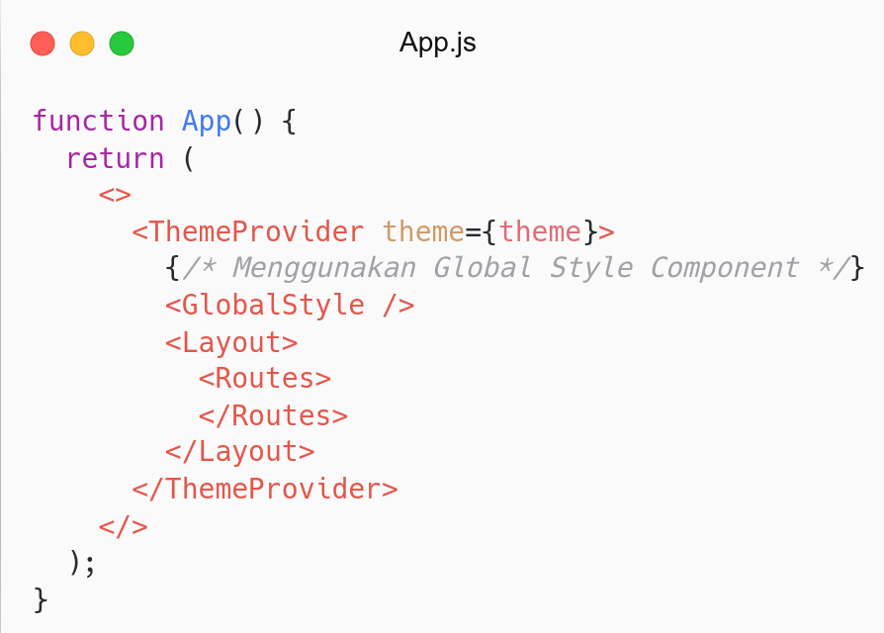
Gunakan Global Style di App Component..

Slide 36
Refactor

Slide 37
# Refactor
Refactor Movie Component.
Using Styled Component.

Slide 38
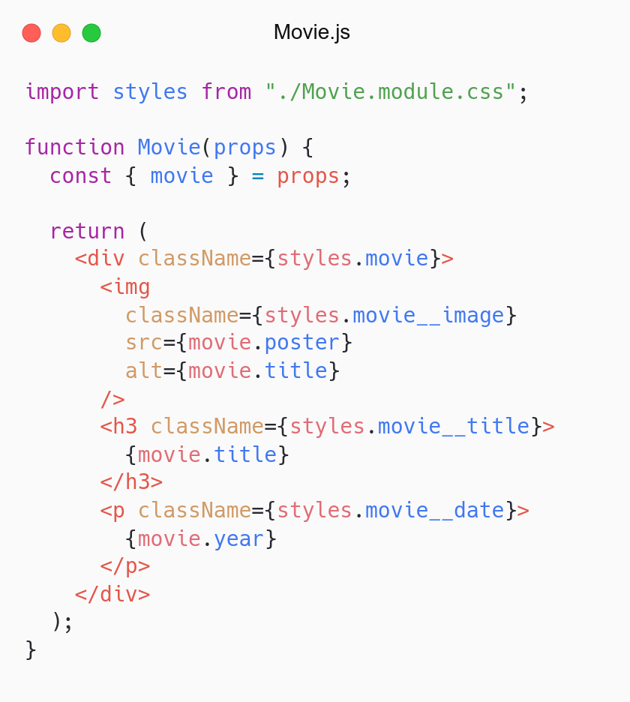
Component Movie.
Separate Component and Style (CSS Module).
How to rewrite Movie to Styled Component?

Slide 39
# Coming from CSS
Convert CSS Module to Styled Component.
Styled Component can style any component.
Rewrite Component and attach style at once.
Referensi: Styled - Coming from CSS.

Slide 40
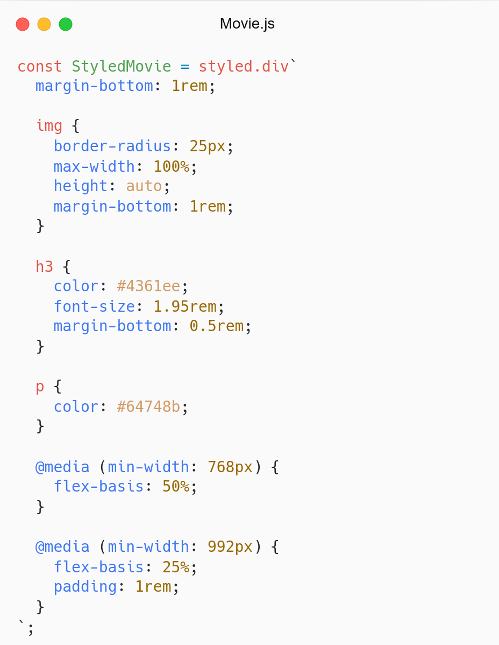
Create StyledMovie Component.
Attach Style from CSS Modules.
Prefix Styled to avoid clash with Movie.
No need className.

Slide 41
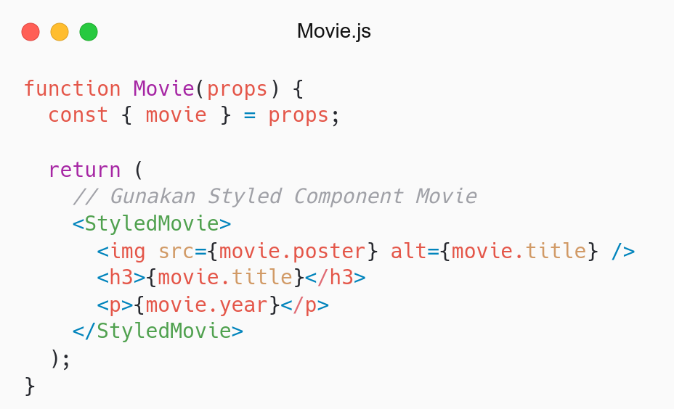
No need className.
We can separate Component and Styled Component.

Slide 42
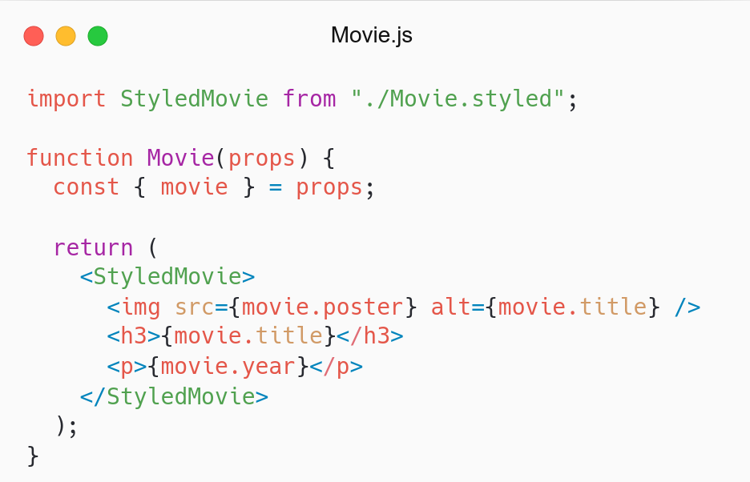
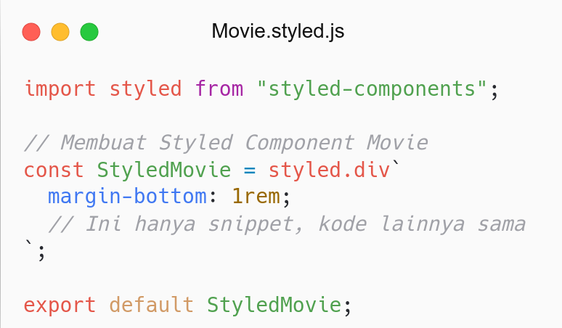
Movie Component
Styled Component (Movie)

Slide 43
QnA

Slide 44
Take Away

Slide 45
# TODO
Refactor Navbar, Hero, Footer use Styled Component.
Add size props to Button Component (Try to use theming).
Try to create some UI Component like Chakra (optional):
Typography: Heading, Paragraph
Form: Form, Label, Input
Media: Image
Size (Props):
sm: font-size: 0.8rem, padding: 0.2rem 0.5rem.
md (default): font-size: 1rem, padding: 0.5rem 1rem.
lg: font-size: 1.3rem, padding: 0.5rem 1rem;

Slide 46
# Assignment
Push code to Repository Github (use branch for task management).
No zip and don’t push node_nodules folder.
Submit link repository to elena.
Kamis: 26 Mei 2022, Link Elena.
Jumat: 28 Mei 2022, Link Elena.

Slide 47
Attendance

Slide 48
Thanks

